Slide 1
Intro to Databases
CodeBreak Winter 2016

Slide 2
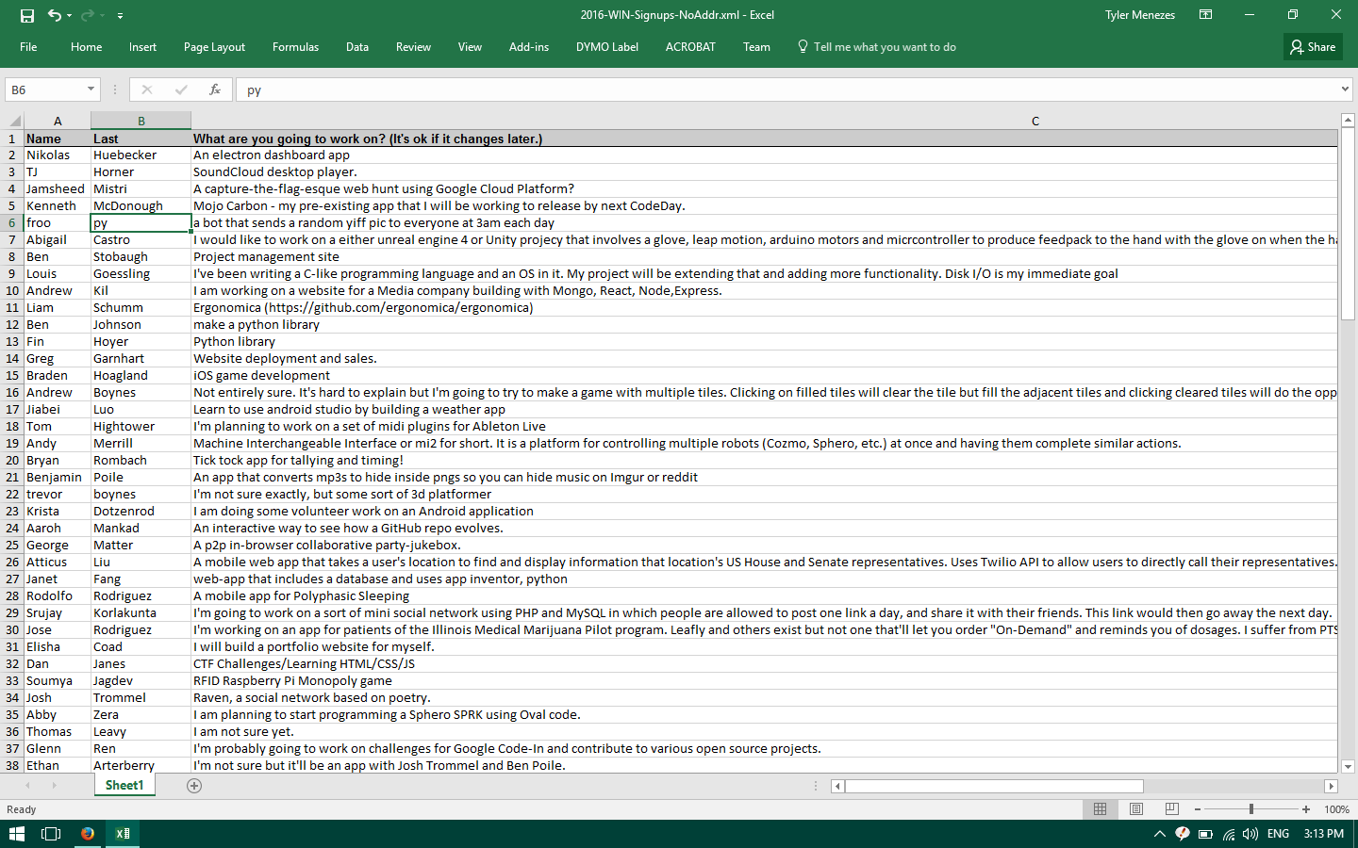
This is a database!

Slide 3
Databases store stuff in a way that…
Reads/writes quickly
Can be searched, sorted, etc
Usually structured in a known way

Slide 4
Structured Format
Tables store related data, e.g.
“codedays”
“attendees”
“projects”
Columns group specific types of data, e.g. for “codedays”:
“starts”
“ends”
“name”
“address”
“capacity”
Rows group entries

Slide 5
Example “codedays” Table
`codedays`
starts | ends | name | address | capacity
December 17, 2011 | December 18, 2011 | CodeDay Seattle December 2011 | StudentRND,…, Bellevue WA | 60
February 11, 2012 | February 12, 2012 | CodeDay Seattle February 2012 | StudentRND, …, Bellevue WA | 60
July 1, 2012 | July 2, 2012 | CodeDay MEGA | ThinkSpace, …, Redmond WA | 100
August 13, 2012 | August 14, 2012 | CodeDay August 2012 | ThinkSpace, …, Redmond WA | 100

Slide 6
“Relational”
How do we go from a student to an event?
Reference it!
Must be able to uniquely identify each object – give it an id.
Most databases can auto-generate a unique id (“auto_increment”)

Slide 7
Now we have…
`codedays`
id | starts | ends | name | address | capacity
1 | December 17, 2011 | December 18, 2011 | CodeDay Seattle December 2011 | StudentRND,…, Bellevue WA | 60
2 | February 11, 2012 | February 12, 2012 | CodeDay Seattle February 2012 | StudentRND, …, Bellevue WA | 60
3 | July 1, 2012 | July 2, 2012 | CodeDay MEGA | ThinkSpace, …, Redmond WA | 100
4 | August 13, 2012 | August 14, 2012 | CodeDay August 2012 | ThinkSpace, …, Redmond WA | 100

Slide 8
Tracking ticket sales
`attendees`
id | first_name | last_name | email | codeday_id
1 | Tyler | Menezes | tyler@srnd.org | 1
2 | Adam | Ryman | adam@srnd.org | 1
3 | Edward | Jiang | edj@srnd.org | 1
4 | Adam | Ryman | tyler@srnd.org | 2
5 | Edward | Jiang | edj@srnd.org | 2
6 | Tyler | Menezes | tyler@srnd.org | 2
7 | Kevin | Beason | kevin@srnd.org | 2
8 | Zaq | Wiedmann | zaq@srnd.org | 2

Slide 9
“What’s the name of the CodeDay that Kevin went to?”
`attendees`
id | first_name | last_name | email | codeday_id
7 | Kevin | Beason | kevin@srnd.org | 2
`codedays`
id | starts | ends | name | address | capacity
2 | February 11, 2012 | February 12, 2012 | CodeDay Seattle February 2012 | StudentRND, …, Bellevue WA | 60

Slide 10
How do you create/edit/see the tables?
It’s not like Excel
You have to use “SQL”
“Structured Query Language”
Like with Java or Python, you have to write in a specific format
In the command line (“mysql”) or from a program

Slide 11
SELECT
SELECT * FROM attendees;
`attendees`
id | first_name | last_name | email | codeday_id
1 | Tyler | Menezes | tyler@srnd.org | 1
2 | Adam | Ryman | adam@srnd.org | 1
3 | Edward | Jiang | edj@srnd.org | 1
4 | Adam | Ryman | tyler@srnd.org | 2
5 | Edward | Jiang | edj@srnd.org | 2
6 | Tyler | Menezes | tyler@srnd.org | 2
7 | Kevin | Beason | kevin@srnd.org | 2
8 | Zaq | Wiedmann | zaq@srnd.org | 2

Slide 12
Being more SELECTive
SELECT id, email FROM attendees;
`attendees`
id | email
1 | tyler@srnd.org
2 | adam@srnd.org
3 | edj@srnd.org
4 | tyler@srnd.org
5 | edj@srnd.org
6 | tyler@srnd.org
7 | kevin@srnd.org
8 | zaq@srnd.org

Slide 13
WHERE clause
SELECT * FROM attendees WHERE first_name = “Tyler”;
`attendees`
id | first_name | last_name | email | codeday_id
1 | Tyler | Menezes | tyler@srnd.org | 1
6 | Tyler | Menezes | tyler@srnd.org | 2

Slide 14
JOIN (the relational part)
SELECT attendees.first_name, codedays.name FROM attendees INNER JOIN codedays ON attendees.codeday_id = codedays.id WHERE first_name = “Tyler”;
`attendees`
first_name | name
Tyler | CodeDay Seattle December 2011
Tyler | CodeDay Seattle February 2012

Slide 15
INSERT, UPDATE, CREATE TABLE, etc
Google it!

Slide 16
How does this help me?
You app generates SQL
Send the SQL
Get the results
???
Profit

Slide 17
Generating SQL is annoying
Use an “ORM” – Object Relational Mapper
SELECT e.g.: var me = Users.Where(“username”, “=“, “tylermenezes”).First();
UPDATE e.g.: me.FirstName = “TylerIsTheBest”; me.Save();

Slide 18
Security
“SQL Injection”:
SELECT * FROM users WHERE username = “$USERNAME”;
What if $USERNAME is set to “; DROP TABLE users; --
SELECT * FROM users WHERE username = “”; DROP TABLE users;
(-- comments everything else out)
Permissions
Don’t put passwords in client apps.

Slide 19
Common Database Providers
SQLite
Stores the data in a file, kind of like an Excel workbook
Not that fast
Not great for multiple users
MySQL
Most common
“Server” – you need to be running MySQL in the background all the time

Slide 20
Less Common Database Providers
MariaDB
MySQL for people who don’t like Oracle (which owns MySQL)
Literally just MySQL
Still says MySQL in many places
Postgres
Like MySQL but faster and with more features
More confusing

Slide 21
“NoSQL”
Uses SQL
Poorly named by internet hipsters in 2010-ish
Has existed for longer than “SQL”
Anything that stores data “non-relationally”
Can literally just be a Dictionary, or something that stores “documents”

Slide 22
Further Reading Googling
“MySQL Getting Started”
“ORM [Your Language of Choice]”

